Slide 1
Attrition Management & Prediction
Case Study
Karthik Radhakrishnan
DDSAnalytics

Slide 2
Introduction
Objective
Identify the top 3 factors that contribute to attrition from the sample data provided
Identify any job role specific trends
Develop a model to predict attrition and evaluate
Data
Data collected from 870 employees
36 different variables
Includes both numerical and categorical values
No missing values

Slide 3
Approach
Correlation analysis to identify top 3 factors that contribute to turnover
Exploratory data analysis to find the nature of relationship between different variables and Attrition
Insights from analysis and recommendations
Build a model to predict attrition
Model Evaluation

Slide 4

Correlation Analysis

Slide 5
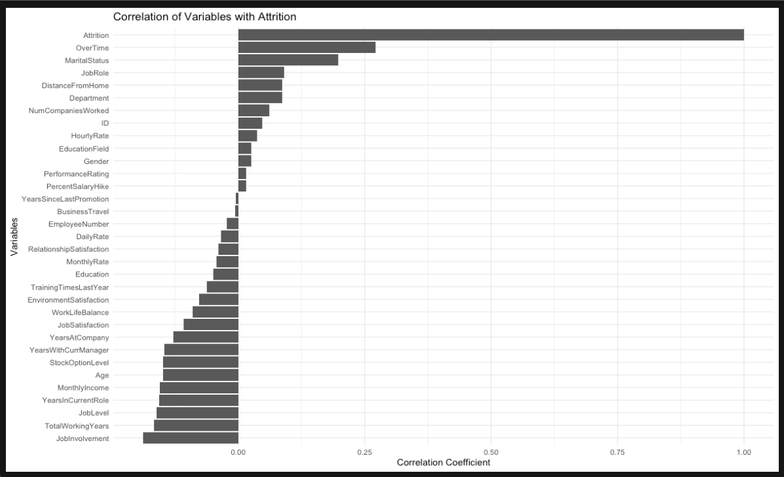
Results of Correlation Analysis
Correlation analysis is a statistical method used to evaluate the strength and direction of the linear relationship between two quantitative variables.
OverTime
MaritalStatus
JobRole
Top 3 factors contributing to turnover as per correlation analysis

Slide 6
Exploratory Data Analysis

Slide 7
Questions of Interest for Analysis
What is the impact of overtime in attrition rate?
Does Martial Status have any relationship with Attrition Rate?
Any job role specific trends with regards to attrition rate?
Which department has less work life balance?

Slide 8
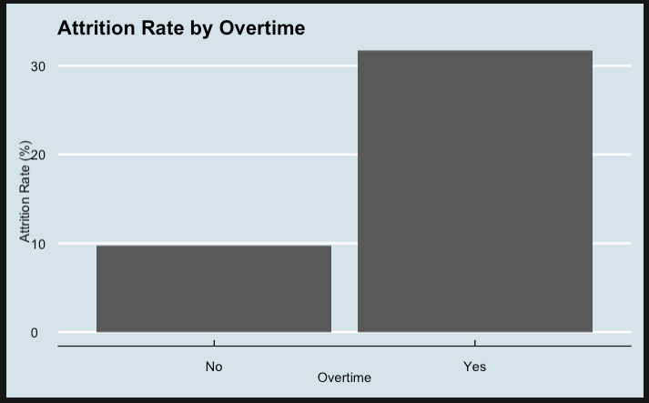
Overtime and Attrition Rate
Insight
Employees who work overtime have a significantly higher attrition rate compared to those who do not work overtime. This suggests that long working hours may be contributing to employee turnover
Recommendation
Implement policies to reduce overtime and ensure employees have a healthy work-life balance.

Slide 9
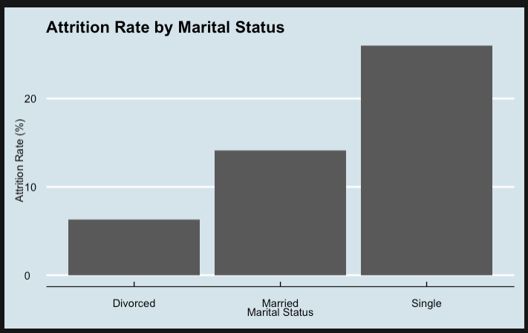
Marital Status and Attrition Rate
Insight
Employees who are single have the highest attrition rate, followed by those who are Married. Divorced employees have the lowest attrition rate. This could indicate that married employees may have more stability or different priorities affecting their decision to stay with the company compared to employees who are single.
Recommendation
Implement programs aimed at improving the job satisfaction of single employees.

Slide 10
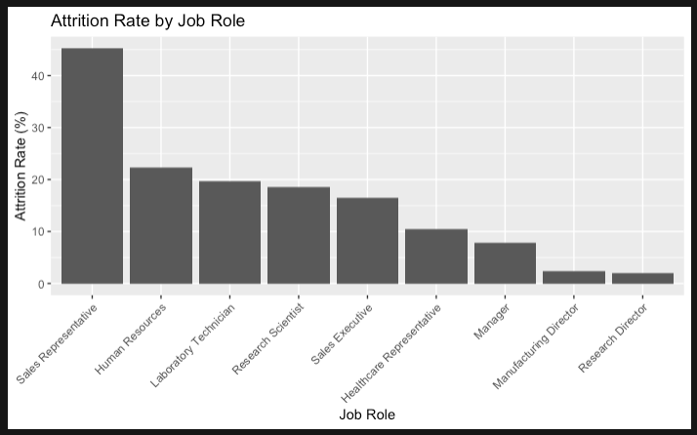
Job Role and Attrition Rate
Insight
Employees in Sales Representative role have high attrition rates. This suggests that job roles with high pressure and target-oriented tasks might see higher turnover.
Recommendation
Develop specific retention strategies for high-turnover roles such as Sales Representatives.

Slide 11
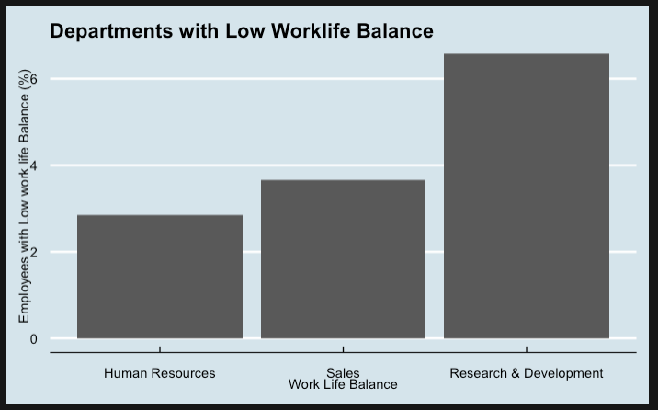
Departments with low work life balance
Insight
Research & Development department has more % of employees who have provided the lowest work life balance rating 1, followed by Sales and Human Resources.
This suggests that departments with high pressure environment and targets can have low work life balance.
Recommendation
Develop department specific interventions to improve work life balance across all departments.

Slide 12
Prediction

Slide 13
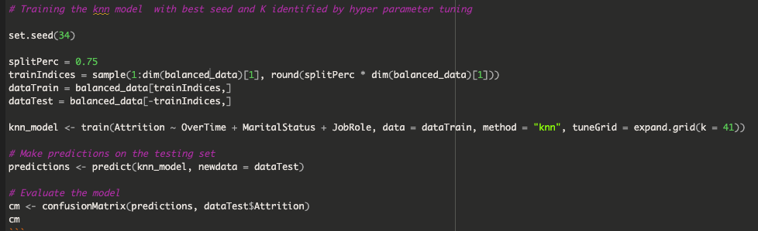
Prediction of Attrition
The K-Nearest Neighbors (KNN) algorithm is a simple, versatile, and widely-used machine learning algorithm primarily used for
classification and regression tasks. For classification, the prediction made based on the majority class among the K neighbors.
knn model is used to predict attrition based on the below top 3 factors contributing for Attrition: Overtime, MaritalStatus, JobRole
Hyperparameter tuning is done to identify the best k value to achieve good accuracy.

Slide 14
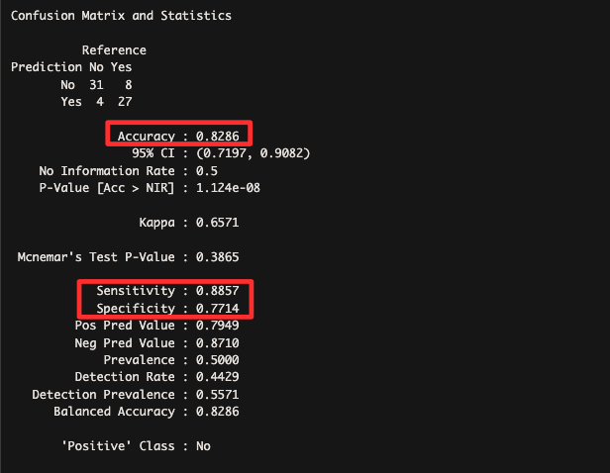
Model Evaluation
Key metrics from model evaluation using training data
  Sensitivity – 89%
  Specificity – 77 %
  Accuracy – 83%
Key Metrics
Accuracy: 0.8286
Number of correctly classified observations/total.
The model correctly predicted the outcome 83 % of the time.
95% CI (Confidence Interval): (0.7197, 0.9082)
This indicates the range within which the true accuracy of the model lies
with 95% confidence.
Sensitivity : 0.8857
This measures the proportion of actual positives that are correctly identified to the total positives. The model correctly identifies 89 % of the actual non attrition cases.
Specificity (True Negative Rate): 0.7714
This measures the proportion of actual negatives that are correctly identified to the total negatives. The model correctly identifies 77 % of the attrition cases.

Slide 15
Summary
Top 3 factors contributing to Attrition
OverTime
MaritalStatus
JobRole
Recommendations
Develop specific retention strategies for high-turnover roles such as Sales Representatives.
Develop strategy to identify and address the factors responsible for low job satisfaction ratings in different job roles.
Develop department specific interventions to improve work life balance across all departments.
Evaluation results of prediction model
Accuracy: 83%
Sensitivity (Recall or True Positive Rate): 89 %
Specificity (True Negative Rate): 77%

